Slide 1
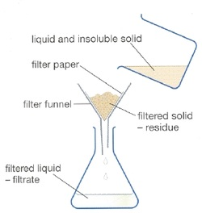
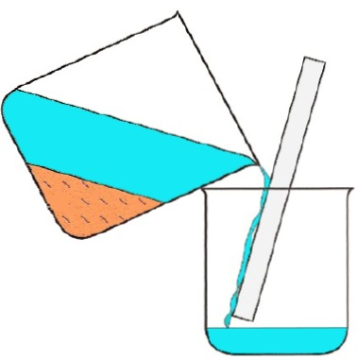
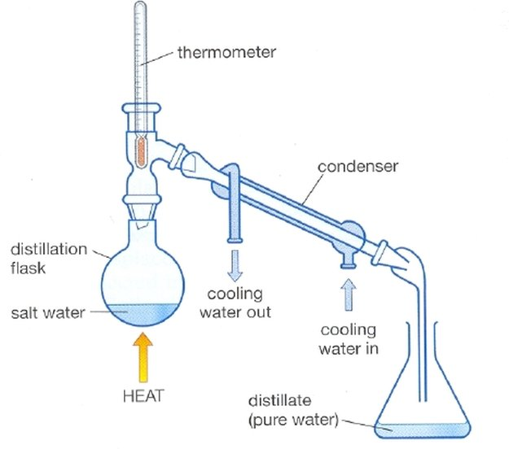
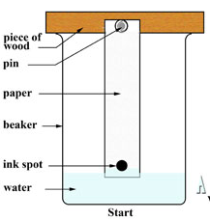
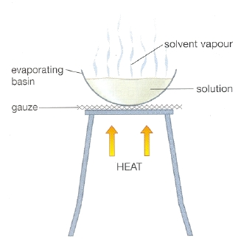
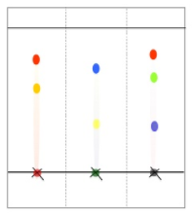
Separation Techniques |  | Links:
Filtration Separates an insoluble solid from a liquid. The solid pieces are too big too fit through the holes in the filter Paper. | Decanting Pour a liquid from the top of a settled solid or a more dense liquid. |  | Distillation Separating substances with different boiling points. Salt water mixture is heated. At 100ºC water boils and the particles gain enough energy to become a gas (water vapour). Boiling point of salt is 1413ºC so it does not boil and stays in the flask. Water vapour rises and travels past the thermometer into the condenser. Thermometer checks the temperature to identify the gas. Condenser cools the water vapour so that it condenses back to liquid water.
Chromatography Method Draw pencil line. Put dot of colour on line. Hang bottom edge (below dot) in the water. Leave until water soak up to almost the top of the paper.. Compare with known substances. Different colours contain different mixtures of inks. The different inks move at different speeds up the paper. This is because of different solubility. Chromatogram | Evaporation Separating a soluble solid from a liquid. Crystallisation Heat until almost all the water has evaporated. Leave for the remaining water to evaporate slowly to form crystals.
Video link
Video link
Video link
Video link

