Slide 1
AC3.1
Describe personal safety responsibilities in the workplace.
Explain what HS£ covers?
Explain what RIDDOR Law covers?
Revision
Question mat
___________________________________________________________________________________________________________________________________________________________________________________________________________________________________________
____________________________________________________________________________________________________________________________________________________________________________________________________________________________________________________________________________________________________________________________________________________________________________________
Explain what the Health and safety at work act (1974) covers?
How does RIDDOR relate to?
Employer | Employee
________________________________________________________________________________________________________________________________________________________________________________________________________________________________________________________________________________________________________________________________________________________________________________________________________________________________________________________________________________________________________________________________________________________________________________________________________________________________________________________________________________________________________________________________________________________________________
How does Health and safety at work act (1974) relate to?
Employer | Employee
What does RIDDOR stand for?
RIDDOR
______________
______________
______________
______________
______________
______________

Slide 2
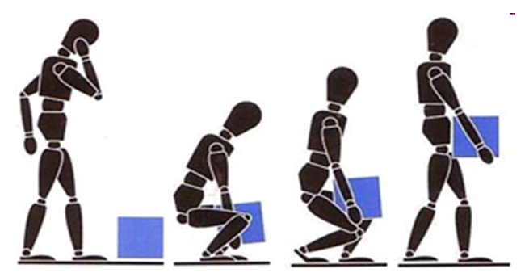
AC3.1
Describe personal safety responsibilities in the workplace.
Label the COSHH symbols
What does PPER stand for?
Revision
Question mat
________________________________________________________________________________________________________________________________________________________________________________________________________________________________________________________________________________________________________________________________________________________________________________
How does PPER & manual handing operations regulations relate to:
Employer | Employee
Explain what
COSHH covers?
What
does COSHH stand for?
________________________________________________________________________________________________________________________________________________________________________________________________________________________________________________________________________________________________________________________________________________________________________________
________________________________________________________________________________________________________________________________________________________________________________________________________________________________________________________________________________________________________________________________________________________________________________
How does COSHH relate to:
Employer | Employee
Explain what PPER covers?
______________________________________________________________________________________________________________________________________________________________________________________________________________________________________________________________________________________________________________________________________________________________________________________________________________________________________________________________________________________________________________________________________________________________________________________________________________________________________________________________________________________________________
Explain what manual handing operations regulations cover?
________________________________________________________________________________________________________________________________________________________________________________________________________________________________________________________________________________________________________________________________________________________________________________

Slide 3
AC3.2
Identify risks to personal
safety in hospitality and catering.
AC3.3
Recommend personal safety
control measures for hospitality and catering provision.
Revision
Question mat
Control measures
Control measures
Risks
Employers
Safety and security
Employees
Risks
Task – complete the radar. Give at least 5 examples of each.
Control measures
Control measures
Care
Maintenance Cleaning
Where are you now?

Slide 4
AC3.2
Identify risks to personal
safety in hospitality and catering.
AC3.3
Recommend personal safety
control measures for hospitality and catering provision.
Revision
Question mat
Control measures
Control measures
Risks
Safety and security
Suppliers
Customers
Risks
Task – complete the radar. Give at least 5 examples of each.
Control measures
Control measures
Care
Maintenance Cleaning
Where are you now?

