Slide 1
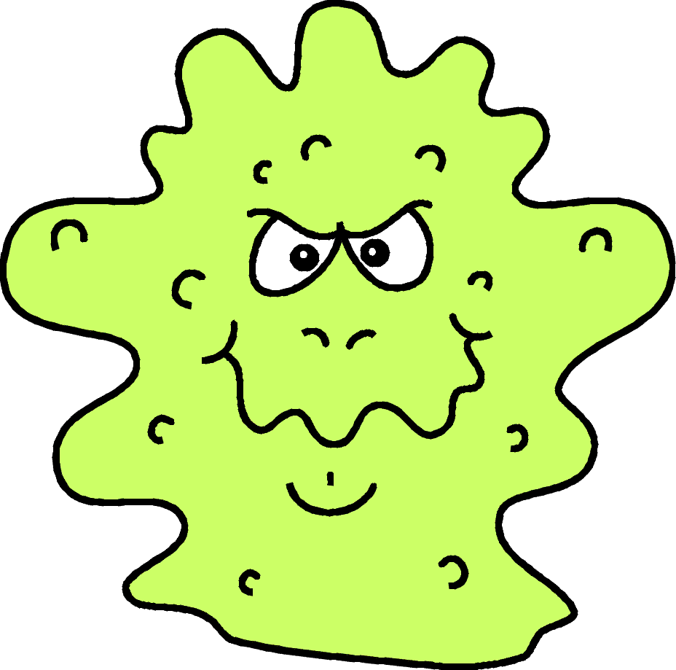
Communicable and
Non-Communicable Diseases

Slide 2
Let’s See If you can guess…
There are 2 Diseases with definitions on your table, one-by-one I will call you up and tell you “Yes” or “No”, the “Yes” group goes to one side of the room and the “No” group to the other.
Try and guess how I am grouping the diseases and in what ways.
Yes: Cold, Flu, Mono, Chicken Pox, Pneumonia, Rubella, Hepatitis, Tuberculosis, Strep Throat.
No: Cancer, Heart Disease, Diabetes, Allergies, Asthma, Arthritis.

Slide 3
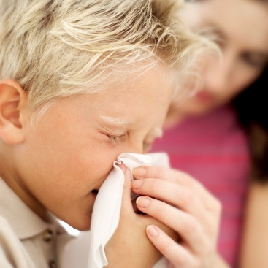
Definitions
Communicable disease: a disease that can be spread to a person from another person, an animal or object. Ex: common cold, influenza, mononucleosis, etc.
Non-communicable disease: a disease that can NOT be spread from person to person. Ex: cancer, heart disease, asthma, etc.

Slide 4
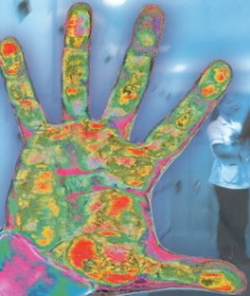
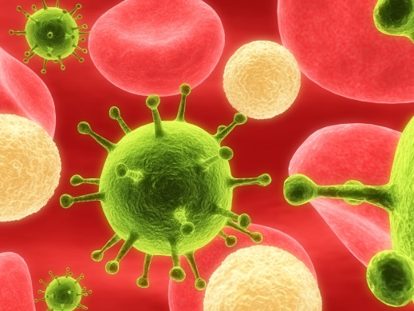
Definitions
Disease: Any condition that interferes with the proper functioning of the body or mind.
Pathogens: Disease-Causing Organisms that are so small they can only be seen through a microscope. Also known as Pathogens
Infection: A condition that occurs when germs enter the body, multiply and cause harm.

Slide 5
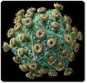
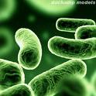


Four Types of Pathogen:
Virus: smallest simplest life form. Not alive, and cause upper respiratory infections and many other type of diseases.
Bacteria: simple one-celled organisms. They are everywhere. Not all bacteria is bad.
Fungi: more complex than bacteria, but cannot make their own food. Thrive in warm, moist environments.
Protozoa: one celled, animal like organisms.

Slide 6


How do Pathogens Spread??
Direct contact with others; EXAMPLE: Shaking hands with someone or kissing an infected person.
Indirect contact with others; EXAMPLE: Sharing drinking glasses or eating from the same spoon or fork as an infected person.
Contact with contaminated food and water; EXAMPLE: Undercooked foods or water that doesn’t look very clean.
Contact with animals and insects; EXAMPLE: A tick bite which can spread Lyme disease. Mosquitos and other bugs.

Slide 7
LESSON REVIEW!
Make Vocabulary flashcards for each of the UNDERLINED words we have covered in this lesson.
Work on Chapter Lesson Review. Questions 1-5. COMPLETE SENTENCES!

Slide 8
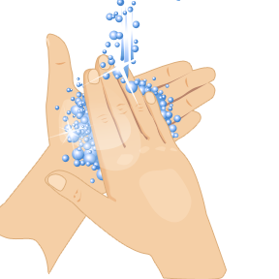
How can you keep pathogens from spreading?
List 3 ways you think you can stop germs from spreading? (2 minutes to complete)
Create a commercial or skit as a group about one way to keep germs from spreading and present it to the class. Be CREATIVE! Must Include:
  1. Information from the PowerPoint
  2. Vocabulary Words
  3. Must be at least 1 page in length written out.

Slide 9
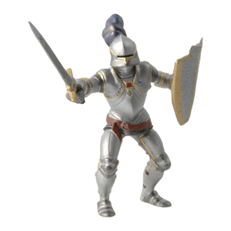
The Body’s Defense Against Infection
The Immune System is a combination of body defenses made up of cells, tissues, and organs that fight germs and disease in the body.
It’s purpose is to help you get better when you are ill and to prevent you from becoming ill in the first place.
Immunity: Your body’s ability
to resist germs that cause a
particular disease.

Slide 10

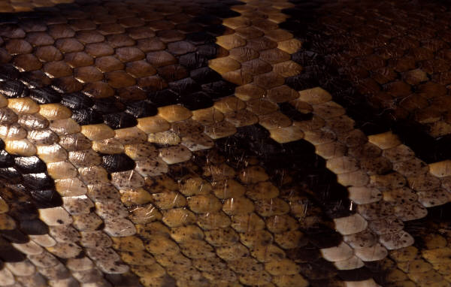

5 Major Barriers to help keep pathogens away.
Our body is an amazing machine which has five main barriers (first line of defense) for keeping our body healthy. They are:
  1. Skin – acts as a protective barrier
  2. Mucous Membranes – line the mouth, nose, throat, eyes and other body parts. These trap germs. Coughing and sneezing gets rid of the germs trapped by these mucus membranes.
  3. Saliva – contains chemicals that destroy many harmful organisms.
  4. Tears – wash away germs. Contains chemicals that kill some harmful organisms.
  5. Stomach Acid – acid kills many germs!

Slide 11
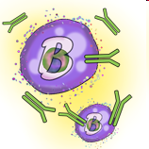
Non-specific and Specific Immune Response
Inflammation: The body’s response to injury or disease, resulting in a condition of swelling, pain, heat, and redness.
http://youtu.be/hu9XIwm0fKE
Antigens: a substance that sends your immune system into action when your body is invaded by pathogens. The body sees these as “invaders”.
Antibodies: proteins that attach to antigens, keeping them from harming the body. How our body responds to antigens, by producing antibodies – our body’s “army of soldiers”.
Vaccine: A preparation of dead or weakened pathogens that causes the immune system to produce antibodies.

Slide 12
LESSON REVIEW!
Make Vocabulary flashcards for each of the UNDERLINED words we have covered in this lesson.
Work on Chapter Lesson Review. Questions 1-5. COMPLETE SENTENCES!

Slide 13
Let’s Put it all together.
So we’ve learned about how the body defends itself from diseases and how to prevent getting germs. Now let’s see what you can come up with.
I want you to create a brochure about fighting diseases and preventing them from what we have learned. Must include:
    1. Title
    2. Information from the slide show
    3. Pictures or drawings
    4. Use vocabulary from the chapter

Slide 14

Communicable Diseases
Contagious Period: The length of time that a particular disease can be spread from person to person.
Colds- Caused by hundreds of different viruses, spread by direct or indirect contact.
Flu- Caused by one of 3 main types of influenza viruses.
Mononucleosis- Viral disease having a severe sore throat and swelling of your throat.
Hepatitis- Viral Disease
Tuberculosis- Bacterial Disease
Pneumonia- Inflammation of the lungs
Strep Throat- Sore throat caused by bacteria

Slide 15

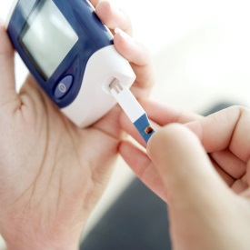
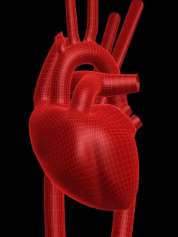
Non Communicable Disease
Cancer- A disease characterized by the rapid and uncontrolled growth of abnormal cells.
Heart Disease- Any condition that weakens the heart and blood vessels and makes them less functional.
Diabetes- A disease that prevents the body from converting food into energy.
Arthritis- A disease of the joints marked by painful swelling and stiffness.
Allergies- Extreme sensitivity to a substance.
Asthma- A condition in which small airways in the lungs narrow, making breathing difficult.

Slide 16
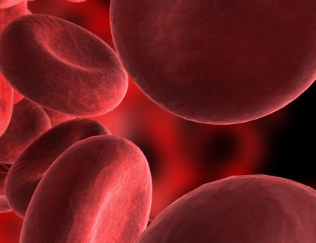
Just Remember:
Communicable; comes from the community, other people.
Non-Communicable; can’t get it
from others.

Slide 17
Getting to know you.
Each person has a notecard at their table.
Mingle around the room and give your name to 3 different people.
Write your name on their card after you introduce yourself.
Once you have 3 names on your card go back to your seat.

Slide 18
Bad News
Check the bottom of your card.
If you have an X on the bottom of your card you just found out you have been infected.
Stand up and read the 3 names on your card.
If your name is called go ahead and stand up.

Slide 19

Sexually Transmitted Diseases
STDs are infections that are spread from person to person through sexual contact.
Common STDs are:
      Chlamydia
      Genital Herpes
      Genital Warts
      Trichomoniasis
      Gonorrhea
      Syphilis
      Pelvic Inflammatory disease (PID)
      HIV/AIDS
How can you avoid an STD? Abstain or don’t have sex until marriage.

Slide 20
What you should know about STDs…
Most STDs are spread ONLY through sexual contact.
You cannot tell if someone has an STD by his or her appearance.
Most STDs have either very mild or no symptoms.
Many STDs can be treated and cured, but early diagnosis is important.
Because treatments for STDs vary, they must be accurately identified.
STDs can recur because the body does not build up an immunity to them.
STDs can cause sterility, blindness, deafness, and birth defects.

Slide 21

HIV/AIDS
HIV (human immunodeficiency virus) is the virus that causes AIDS (acquired immunodeficiency syndrome).
AIDS is a deadly disease that interferes with the body’s natural ability to fight infection.
Opportunistic infection is an infection that rarely occurs in a healthy person. Ex. AIDs patients developing pneumonia that cause death.
Carriers are people who appear healthy but are infected with HIV and can pass it to others.
A blood test is the only way to know whether you have HIV or not.

Slide 22

How does HIV spread?
1. Sexual Contact with an infected person. Just one time is all it takes to spread the virus.
2. Sharing Needles of any kind, mostly through drug users but also there is a risk from getting a tattoo or body piercing because their needles may be unclean.
3. From mother to child either before or after delivery, or through breast-feeding.

Slide 23
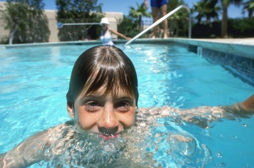


How HIV is NOT Spread
Breathing the air
Being bitten by a mosquito
Swimming in a pool
Sharing Utensils
Donating blood
Hugging and shaking hands
Using the same shower, bathtub, or toilet as an infected person.

Slide 24
LESSON REVIEW!
Make Vocabulary flashcards for each of the UNDERLINED words we have covered in this lesson.
Work on Chapter Lesson Review. Questions 1-5. COMPLETE SENTENCES!

