Slide 1
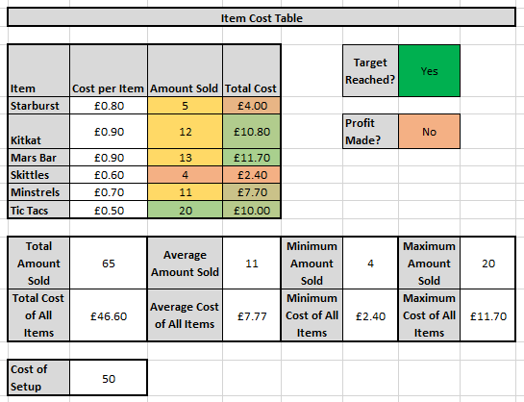
What is Microsoft Excel?
Software for creating spreadsheets
Performs math calculations for you
Sorts and filters data for you
Creates graphs for you
Organises data for you
Makes data tasks easy and user-friendly
Used by 750 million people worldwide
Looked on by employers as more important than Word skills!

Slide 2
ICT – Excel Skills
Step 1 – Open the Worksheet
Step 2 – Complete every activity within the worksheet
Step 3 – Complete additional challenges
Who should you ask?
Try it yourself
Look it up online
Additional Challenges:
Each worksheet contains extra tasks to make you think about why you have made certain choices

